Slide 1
Simulation
Stochastic modeling

Slide 2
Random objects
Random events
Random variables
Random processes
Random point processes

Slide 3
Random point processes (random flows or streams)
simulation

Slide 4
Random point process
interarrival (period)
interval between two subsequent events
time
arrivals
event occurrences
Modeling:
Starting point is given. Model interval until the next event occurs, and so on…

Slide 5
Poisson point process (PPP)
- definitions
1. By features
2. By distribution
Independence: event occurrences are independent of each other.
Ordinarity: only single event may occur at a time moment.
Stationarity: the number of event occurrences in some interval does not depend on the interval starting point.
The number of event occurrences in some time interval with length t is distributed according to Poisson distribution:
This number is completely independent of all the other intervals that are disjoint with considering one.
λ is an intensity of event occurrence = intensity of arrivals = intensity of the process (PPP),
intensity = rate
Probability of event occurrence during interval Δt:

Slide 6
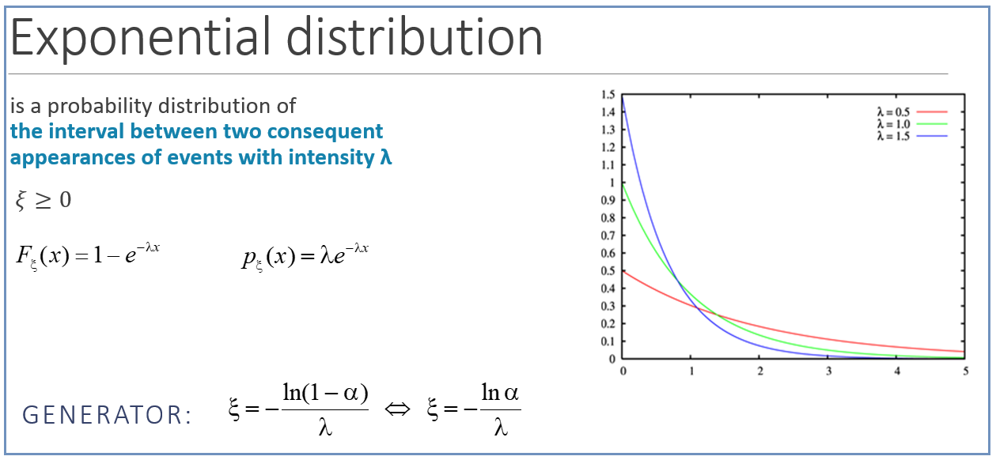
Poisson point process - modeling
Main property of PPP interarrivals
they are all distributed according to Exponential Distribution Law:
PPP MODELING:
t₀ is given
Main property of exponentially distributed interarrivals
you can choose arbitrary point on the time axis during PPP evolution, the residual time will be distributed exponentially with the same parameter λ.

Slide 7
Non-stationary Poisson point process
Stationary PPP:
Independence: event occurrences are independent of each other.
Ordinarity: only single event may occurs at a time moment.
Stationarity: the number of event occurrences in some interval does not depend on the interval starting point.
+ probability of event occurrence
during interval [t; t + Δt]:
non-stationary Poisson point process

Slide 8
Non-stationary Poisson point process
MODELING

Slide 9
Stationary renewal process
interarrival (period)
interval between two subsequent events
= RV with given distribution
time
arrivals
event occurrences
Modeling:
Starting point is given. Model interval until the next event occurs, and so on…

Slide 10
Stationary renewal process
MODELING:
t₀ is given

Slide 11
Markov modulated Poisson Process (MMPP)
- conditional intensities
Continuous-time Markov chain with generator matrix Q
underlying Markov chain
λ
λ₃
λ₂
λ₁
t

Slide 12
MMPP
MODELING

Slide 13
Statistical processing for point processes
We can analyze:
length of inter-arrival intervals τ_{i}
number of points inside time interval of fixed length T
continuous RV
discrete RV

Slide 14
Statistical processing for stochastic processes: number of points
Given: N, T
k := 0
Algorithm 1
Simulate the process during time T -> number of points i
Freq[i] := Freq[i] + 1
k := k + 1
yes
k < N
no
for each i Freq[i] := Freq[i] / N

Slide 15
Statistical processing for stochastic processes: number of points
Given: N, T, and the process is simulated during time T1 >> T
k := 0
Algorithm 2
a := UniformRV(0, T1 – T)
Count number of points inside interval [a; a + T] -> number of points i
Freq[i] := Freq[i] + 1
k := k + 1
yes
k < N
no
for each i Freq[i] := Freq[i] / N

Slide 16
Laboratory #17
Assignment:
Aggregate Poisson point process
Simulate two stationary Poisson point processes with different intensities λ1 and λ2 simultaneously. Capture events of both processes at once. Such process is also called as an aggregate point process.
Perform statistical data processing for the aggregate process. Check does this process match the stationary Poisson point process with intensity (λ1 + λ2).

